Slide 1
Team Members
Ranveer Sahay - 2021CSB024
Raksha Pahariya - 2021CSB029
Ayush Yadav - 2021CSB032
Bezawada Hamsa Tejaswini - 2021CSB069
Sree Sanjana Nettem - 2021CSB080
Pulkit - 2021CSB083
Under the supervision of Dr. Asit Kumar Das,
Professor of Department of Computer Science and Technology
Indian Institute of Engineering Science and Technology, Shibpur
B.TECH MAJOR PROJECT
Title - An approach for developing Intelligent Transport System using Large Language Model and Generative AI

Slide 2
Contents
Introduction
Objective
Datasets Used
Literature Survey
Methodology
LSTM (Long Short-Term Memory)
Graph Attention Network (GAT)
Integration of LSTM and GAT
Diffusion Convolutional Recurrent Neural Network (DCRNN)
Graph Partitioning
Attention Temporal Graph Convolutional Network (A3TGCN)
Conclusion and Future Scope
References

Slide 3
Problem Statement
Urban Traffic Congestion: Rapid urbanization has led to severe traffic congestion, increasing travel time, fuel consumption, and air pollution, which significantly impact the quality of life in cities.
Ineffective Traditional Systems: Existing traffic management systems rely on outdated models that do not adapt to dynamic traffic conditions, such as real-time accidents, road closures, or fluctuating traffic volumes.
Lack of Personalization: Current route optimization systems provide generic, one-size-fits-all recommendations, disregarding individual preferences such as avoiding tolls, minimizing travel time, or considering environmental impact.
Inaccurate Traffic Prediction: Traditional forecasting methods fail to accurately predict traffic patterns, lacking the ability to account for complex, time-dependent factors like weather, road conditions, and driver behavior.
Absence of Comprehensive Evaluation: There is a lack of robust frameworks to evaluate the performance of Intelligent Transport Systems (ITS), making it difficult to compare different models and understand their effectiveness in real-world scenarios.
Objectives
Traffic Prediction Model: Develop a model that forecasts traffic using historical and real-time sensor data.
Route Optimization Model: Design a system that suggests optimal routes based on predictions and user preferences.
Evaluation Framework: Measure performance using metrics like prediction accuracy, route efficiency, and traffic reduction.

Slide 4
Datasets Used
Source of Data: The datasets used in this project are sourced from GitHub repositories, specifically the Traffic Dataset available at GitHub - Traffic Dataset.
METR-LA Dataset: This dataset contains the traffic speed from the sensors installed on different road segments. The data was collected from Los Angeles County from the 207 sensors over the four months from 1st March to 30th June in 2012. The data is collected at 5-minute intervals from the sensors. So, the number of data points per day is 288.
PeMS Dataset: The traffic speed data of the road segments in California, United States is gathered to build the PeMS dataset. The data is collected from Caltrans Performance Measurement System (PeMS) by 39000 sensors. This dataset incorporates the traffic information of District 7 of California from the 228 sensors. The data is gathered at 5 min intervals, and the number of data points per day is 288.
Key Features:
Traffic Speed Data: Contains traffic speed data across various road junctions at specific time intervals. This dataset records the speed of vehicles passing through different sensors located in key areas of a transport network.
Sensor Adjacency Matrix: Represents the connectivity between various sensors across the road network. The adjacency matrix is crucial for understanding the spatial dependencies and interactions between different sensors or junctions.

Slide 5
Data Processing:
Preprocessing:
Data Cleaning: The dataset undergoes a cleaning process to handle missing or incorrect entries. This may involve removing outliers, correcting errors, and replacing missing values.
Normalization: The speed data is normalized to a standard range (e.g., [0, 1]) to ensure that the LSTM model processes the data efficiently and maintains consistency across inputs.
Handling Missing Values: Zero values are replaced with NaN, followed by forward filling (ffill) and filling remaining missing data with the mean of the respective column.
Sequence Generation: The dataset is converted into sequences of data points to be fed into the LSTM model, allowing it to predict traffic speed at future time steps based on historical data.
Visualization:
Speed vs Time: A line graph is used to show how traffic speed varies over time at specific road junctions, helping to visualize peak hours, congestion periods, and overall traffic trends.
Traffic Density Maps: Heatmaps are generated to visualize the concentration of traffic at different times of the day. These maps help in understanding traffic congestion patterns across the network.
Sensor Connectivity: Visualizations like adjacency matrices can be plotted to represent the spatial relationships between sensors, helping to better understand the traffic flow dynamics.

Slide 6
Literature Survey
LSTM (Long Short-Term Memory) for Traffic Forecasting
LSTM is a specialized type of recurrent neural network (RNN) designed to handle sequential data with long-term dependencies.
It addresses the vanishing gradient problem common in traditional RNNs, enabling effective learning of temporal patterns over long time horizons.
In traffic forecasting, LSTM is applied to learn and predict temporal dependencies in traffic data, such as periodic traffic flow, congestion patterns, and trends over time.
By using historical speed, volume, or flow data as input, LSTM models can predict future traffic conditions at specific locations or across an entire network.
The model's inherent ability to retain information over long sequences makes it suitable for time-series tasks like traffic forecasting.

Slide 7
DCRNN (Diffusion Convolutional Recurrent Neural Network)
DCRNN integrates diffusion convolution to capture spatial dependencies (e.g., how nearby traffic impacts each location) and recurrent neural networks to capture temporal dependencies over time.
The model employs graph structures to model the road network and diffusion convolutional layers to manage the direction and strength of traffic flows, aiming to accurately forecast traffic conditions in the short term.
A3T-GCN model (Attention Temporal Graph Convolutional Network)
A3T-GCN model (Attention Temporal Graph Convolutional Network) is applied to the METR-LA dataset for traffic forecasting.
The model combines attention mechanisms and temporal graph convolutions to predict future traffic speeds by effectively capturing spatial and temporal dependencies.
This method leverages graph-based deep learning in PyTorch Geometric Temporal, enabling efficient traffic forecasting across road networks represented as graphs.

Slide 8
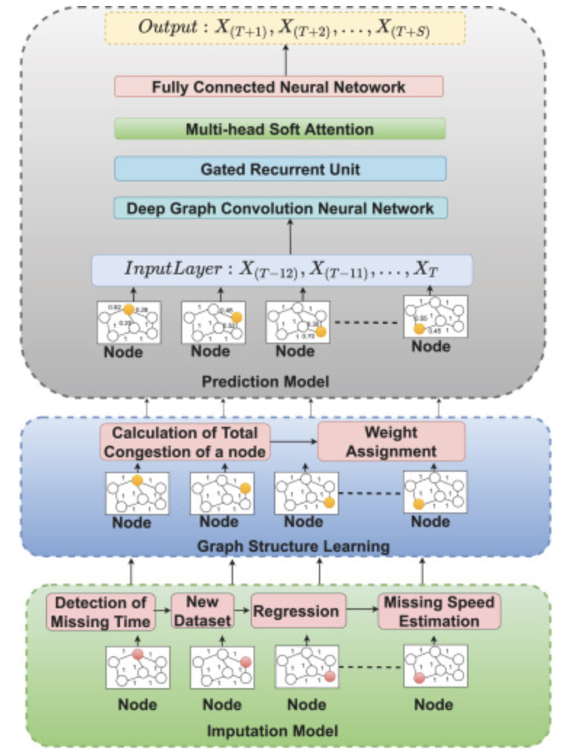
Methodology
The proposed framework has three key components: a missing data imputation model, graph structure learning and a traffic speed prediction model.
The first component uses a machine learning-based technique to handle spatial-temporal missing data.
This imputation leverages spatial information, temporal trends, and dynamic attention factors, calculated using the traffic data from neighboring nodes and surrounding hours over the past and future three days.
The attention factor, estimated via regression, along with neighboring traffic speeds, is used to predict the missing traffic speeds, enhancing the accuracy of traffic speed prediction.

Slide 9
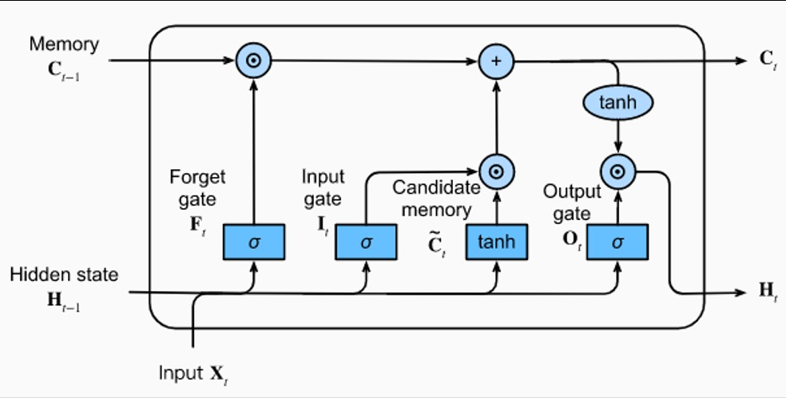
Long Short-Term Memory (LSTM)
LSTM networks are a type of Recurrent Neural Network (RNN) designed to handle long-term dependencies in sequential data. LSTM overcomes the vanishing gradient problem found in traditional RNNs, making it suitable for time-series tasks like traffic prediction.
Architecture
Forget Gate: Determines which information from the previous time step should be discarded.
Input Gate: Decides which new information should be added to the cell state.
Output Gate: Determines what information from the cell state should be passed to the next layer.
Cell State: Serves as the memory, retaining long-term information that influences future predictions.

Slide 10
Application in Traffic Prediction
LSTM captures temporal dependencies in traffic data.
It predicts : Traffic congestion levels, Vehicle speeds and Traffic patterns during peak hours.
Crucial for Intelligent Transport Systems (ITS) that rely on forecasting future traffic conditions.
Limitations
LSTM does not model spatial relationships in traffic networks.
It cannot fully capture interactions between traffic nodes or road segments in complex networks.

Slide 11
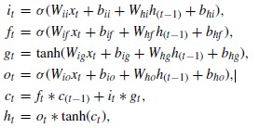
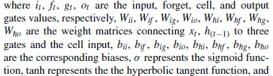
Mathematics behind LSTM
The gating units have three types, namely, input gate, forget gate, and output gate, which are used to decide whether to add or remove information to a cell state.
Given data xt , the cell output state ct and the hidden layer, output ht can be computed by:
Given an input, future predictions are computed by

Slide 12
Graph Attention Network (GAT)
GAT operates on graph-structured data, employing an attention mechanism to focus on the most relevant neighbors in a graph. This mechanism allows GAT to capture spatial dependencies within a traffic network.
Architecture
Graph Representation: Traffic network represented as a graph, where nodes are intersections/road segments, and edges represent connections.
Attention Mechanism: Each node computes an attention score for its neighbors, determining their influence on the node's prediction.
Application in Traffic Prediction
GAT excels at modeling spatial dependencies within a traffic network.
It analyzes how traffic conditions at one intersection influence nearby intersections, crucial for congestion modeling.
Limitations
GAT does not consider temporal dependencies, meaning it can’t predict how traffic conditions change over time.
It requires integration with temporal models like LSTM for accurate predictions that account for both spatial and temporal dynamics.

Slide 13
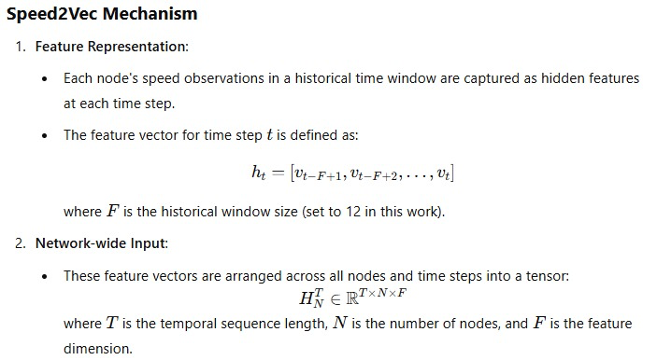
Its advantages include :
Directly utilizes time-series data without needing a sequence-to-sequence structure, simplifying model design.
Efficiently captures sufficient temporal features while avoiding redundancy or excessive computational overhead.

Slide 14
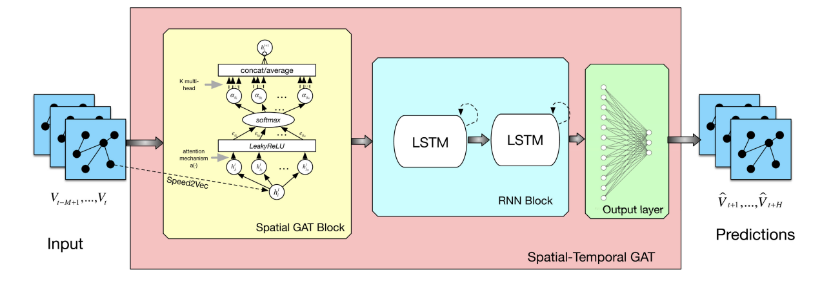
Integration of LSTM and GAT
Complementary Strengths
LSTM: Captures temporal patterns and how traffic evolves over time.
GAT: Models spatial relationships, capturing how conditions at one intersection influence others.
Workflow
Input: Historical traffic data and graph representations of the road network.

Slide 15
Processing:
GAT models the spatial dependencies between nodes in the traffic network.
LSTM takes the output from GAT to learn the temporal dependencies of traffic conditions.
Output: Accurate predictions that combine both spatial and temporal factors.
Benefits
Improved prediction accuracy by addressing both spatial and temporal dimensions.
Scalability for large and dynamic traffic networks.
Better adaptability to real-time changes in traffic conditions.

Slide 16
Training and Evaluation:
Data Splitting: The data is split into 80% for training and 20% for testing to assess the model's ability to generalize.
Model Training:
Architecture: The LSTM model includes two bidirectional LSTM layers (32+16, 64+256, 128+32 units) with Xavier initialization, L2 regularization, and batch normalization, followed by dropout layers to prevent overfitting.
Training Configuration: The model was trained for up to 100 epochs with a batch size of 64, using the Adam optimizer and mean squared error (MSE) as the loss function. Early stopping with a patience of 5 was employed to terminate training when validation loss stopped improving.
Validation: Loss and mean absolute error (MAE) were monitored for both training and validation datasets.
Evaluation Metrics:
RMSE (Root Mean Squared Error): Measures the average magnitude of error, providing insight into the model's prediction accuracy.
MAE (Mean Absolute Error): Indicates the average absolute difference between predicted and actual values.
MAPE (Mean Absolute Percentage Error): Evaluates prediction errors relative to actual values.
R2 Score : Indicates the proportion of variance in the target variable explained by the model, with values closer to 1 reflecting better performance.

Slide 17
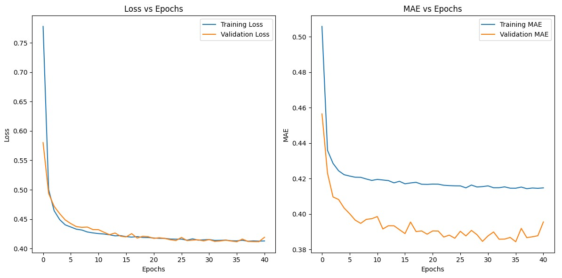

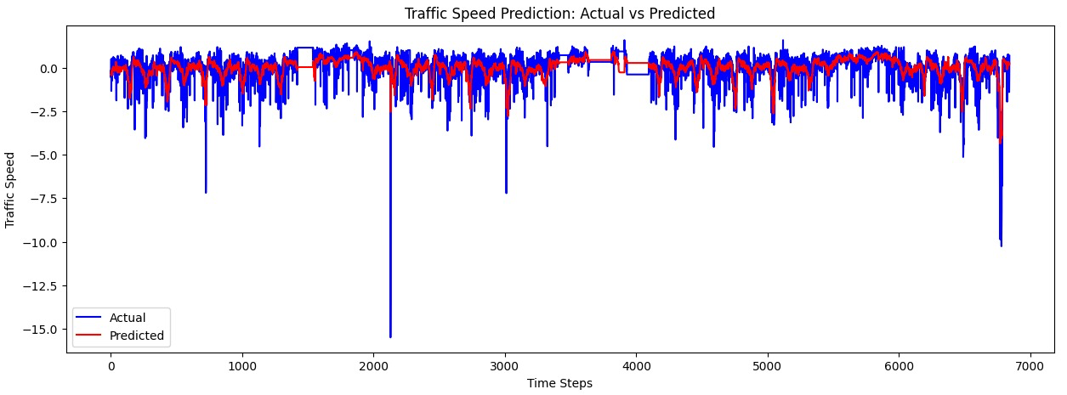
Results and Visualization:
32+16 units

Slide 18
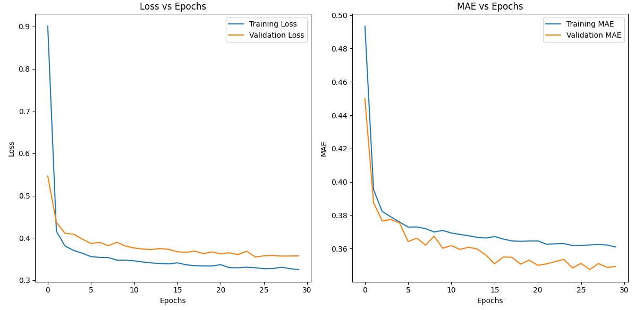

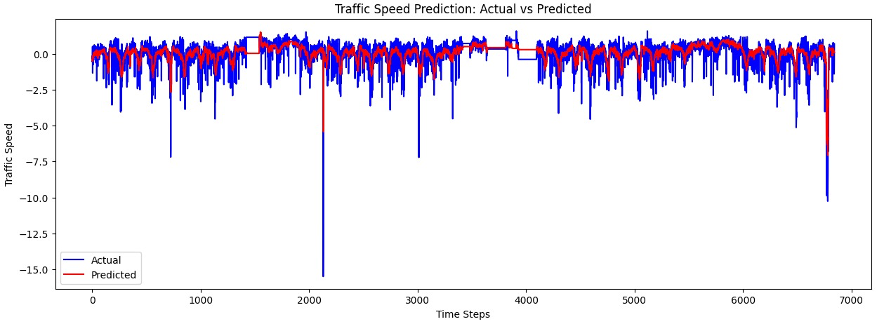
2) 64 + 256 units

Slide 19
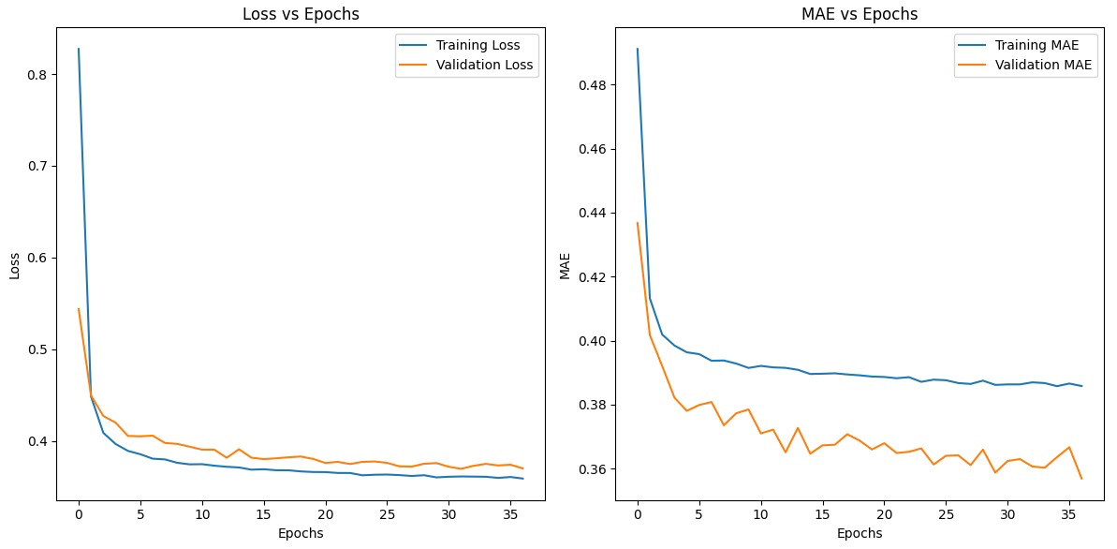

3) 128+32 units

Slide 20
Observations:
RMSE (0.57778): Indicates an average prediction error of approximately 0.5778 units. A lower value suggests reasonable accuracy, depending on the scale of traffic speeds.
MAE (0.34834): On average, the model's predictions deviate from actual values by 0.34834 units. It confirms good performance but indicates potential outliers since RMSE > MAE.
MAPE (3.6874): Extremely high percentage error indicating poor predictive performance. Values above 100% suggest significant discrepancies between predictions and actual traffic speeds.
R-squared (0.67528): The model explains 67.52% of the variance in traffic speeds, suggesting a moderate fit. However, around 32.48% of the variance remains unexplained, indicating room for improvement.

Slide 21
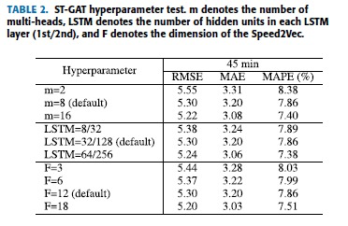
Applications
Traffic Signal Optimization - Adjusting traffic signal timings based on real-time traffic flow predictions to reduce congestion.
Navigation Assistance - Providing real-time route suggestions by forecasting future congestion trends along various routes.
Emergency Response - Identifying traffic hotspots and providing optimized routes for emergency vehicles to navigate through congestion.
Conclusion
The combination of LSTM and GAT forms a robust framework for traffic prediction.
LSTM addresses temporal dependencies, while GAT captures spatial relationships within a road network.
This integrated approach enhances the accuracy and adaptability of traffic forecasting, contributing to more efficient and intelligent transport systems.

Slide 22
Diffusion Convolutional Recurrent Neural Network for traffic forecasting
Traffic forecasting
Given :
Historic traffic metrics {speed, flow, etc}
Road network distance and connectivity
Predict :
Develop a system capable of forecasting traffic conditions (e.g., speed, flow) across a network of sensors by capturing complex spatial and temporal dependencies inherent in the transportation network.
The goal is to optimize traffic flow, reduce congestion, and enable better transportation planning.

Slide 23
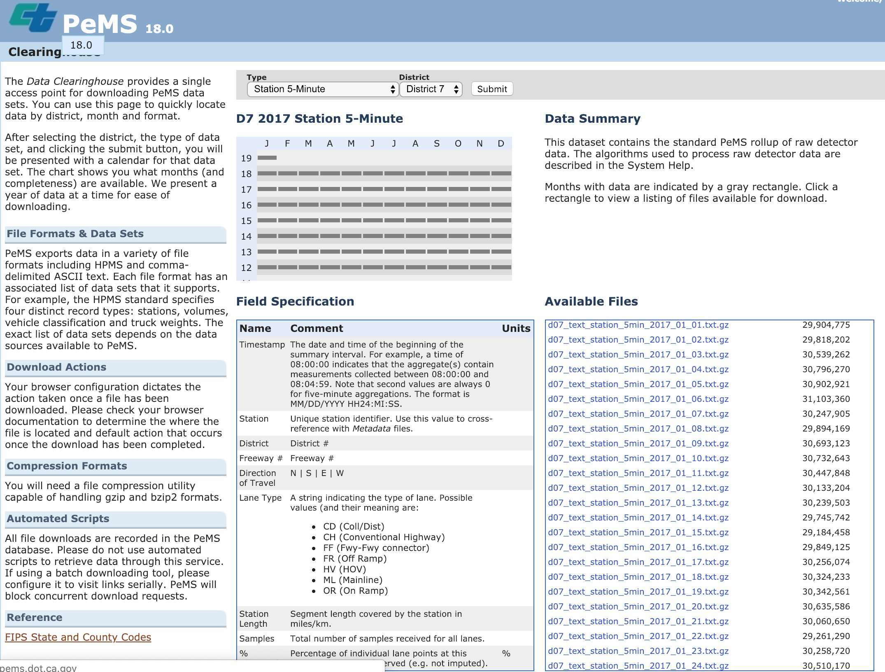
Traffic data from Caltrans Performance Measurement System (PeMS)
The data includes:
Timestamp
Loop IDs
District
Freeway name
Freeway direction
Total flow
Average speed

Slide 24
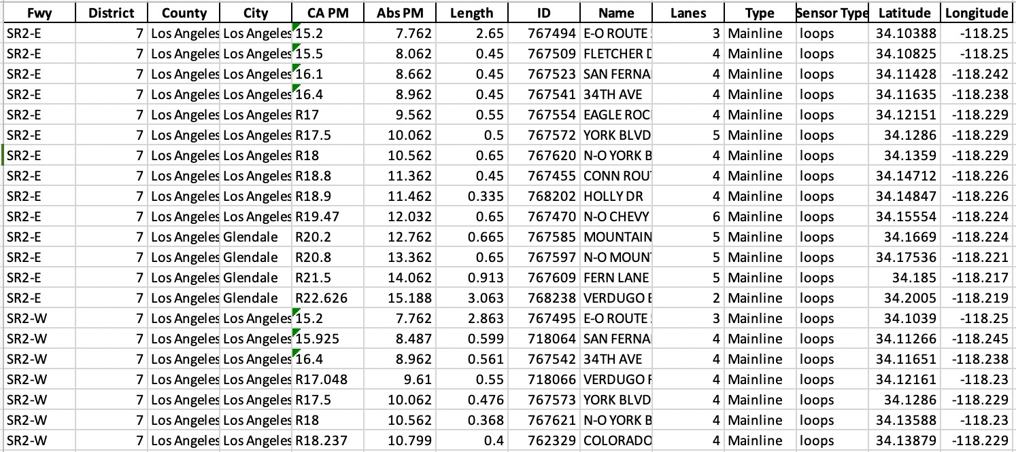
Location data of Loop IDs

Slide 25
DataSet Details
Freeway (Fwy): The name of the highway (e.g., SR2) and its traffic direction (e.g., E for Eastbound, W for Westbound).
District: The California Department of Transportation (Caltrans) district number where the freeway segment is located
County: The county name where the freeway segment exists.
City: The city name associated with the freeway segment.
CA PM: The official California post-mile marker for the freeway segment.
Abs PM: The absolute cumulative mileage from the starting point of the freeway.
Length: The length of the freeway segment in miles.
ID: A unique identifier for the sensor or loop detector in the freeway segment.
Name: A nearby road or landmark for identifying the location of the segment.
Lanes: The number of lanes in the freeway segment
Type: Specifies the type of road (e.g., Mainline for primary roads).
Sensor Type: Indicates the kind of sensor used, such as "loops" for inductive loop detectors.
Latitude: The geographical latitude of the sensor or segment location.
Longitude: The geographical longitude of the sensor or segment location.

Slide 26
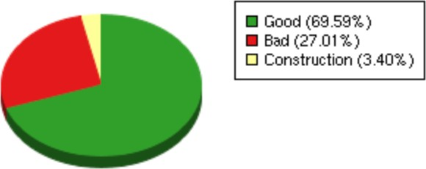
Available data set for Caltrans
District | Total Stations
District 3 | 1247
District 4 | 3880
District 5 | 382
District 6 | 624
District 7 | 4856
District 8 | 2115
District 10 | 1189
District 11 | 1502
District 12 | 2539
Total | 18334
http://pems.dot.ca.gov/

Slide 27
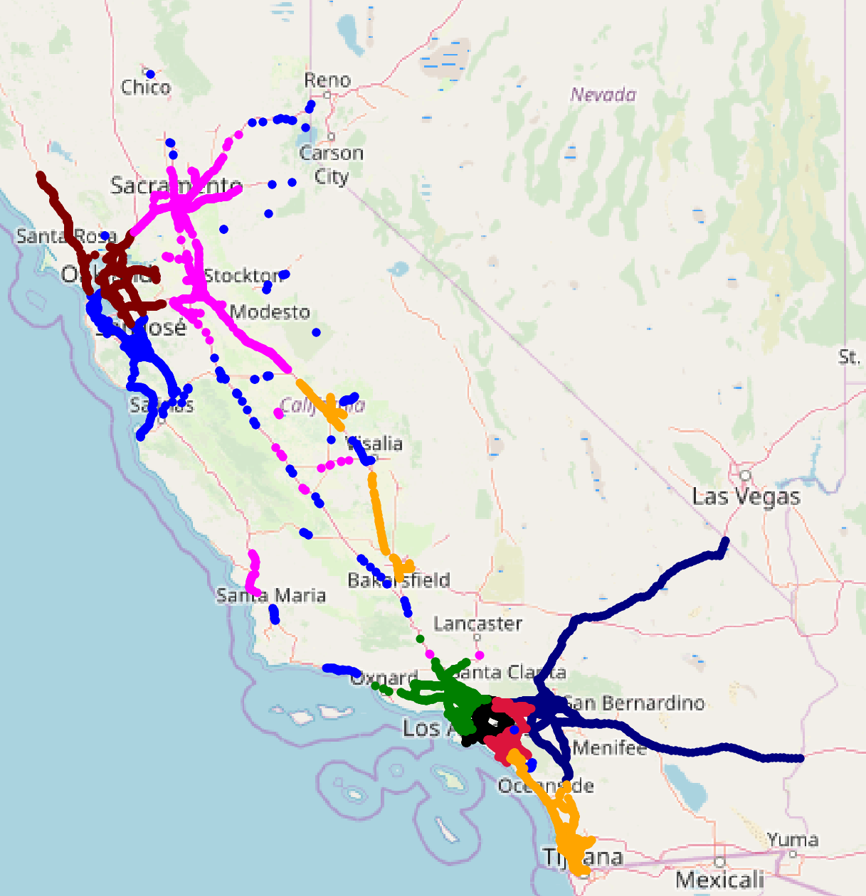
Available data set for Caltrans
Total : 11, 160 detector stations Duration: 1st Jan 2018 to 31st Dec 2018

Slide 28
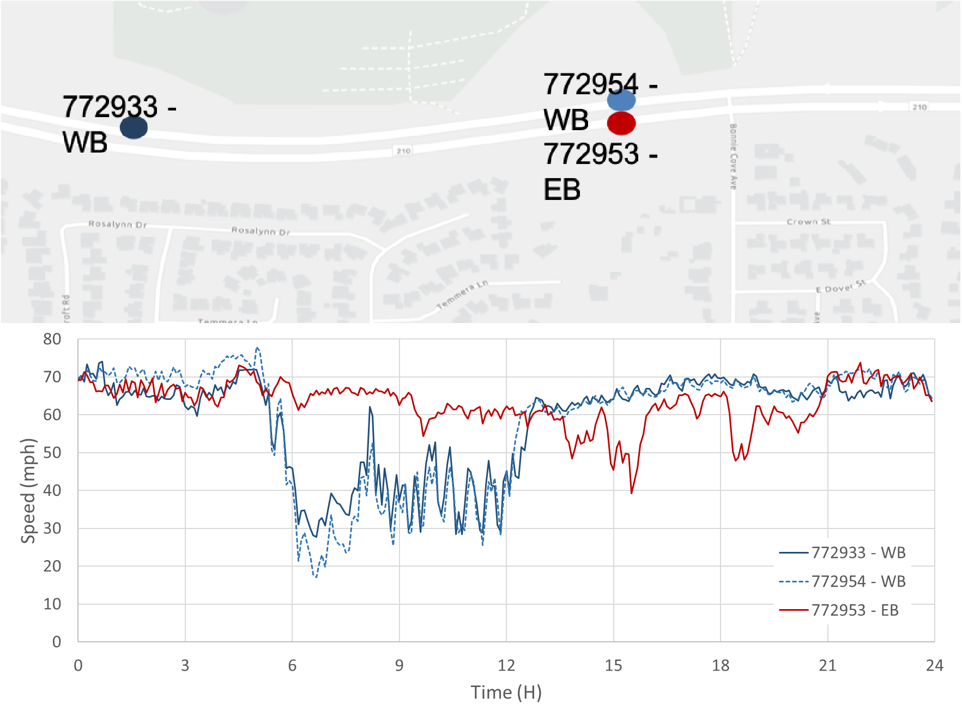
Challenges
Complex spatial dependency
Non-stationary temporal dynamics
Non-Euclidean spatial geometry
Model each sensor independently fail to capture spatial correlation

Slide 29
Challenges in Traffic Prediction
Complex Spatial Dependencies: A traffic jam at one sensor location can lead to congestion at downstream sensors due to spillover effects.
Non-Stationary Temporal Dynamics: Traffic volume during morning rush hours is significantly higher compared to late-night hours.
Non-Euclidean Spatial Geometry: A city's road network includes irregular(graph-based) intersections and overpasses that cannot be represented on a simple Cartesian grid.
Failure to Capture Spatial Correlations: Predicting traffic for one road sensor without considering data from nearby sensors may miss patterns like coordinated signal timings.

Slide 30
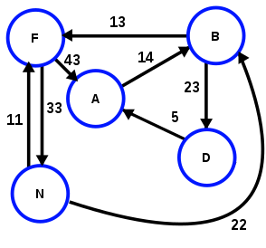
Forecasting for multiple loop detector/sensors
Capturing the road network in terms of graphs
Transportation network as graph
V = Vertices (sensors)
E = Edges (roads)
A = Weighted adjacency matrix
(A function of the road network distance)

Slide 31
Network distance computation
Purpose: To compute the shortest driving distance between loop detectors.
Steps:
First, identify the nearest neighbor for each loop ID using Euclidean distance (calculated based on latitude and longitude). This speeds up the process by narrowing the candidate pairs.
Query the OSRM server with the exact latitude and longitude of the loop IDs to compute the shortest driving distance. This ensures accurate results based on road network topology.

Slide 32
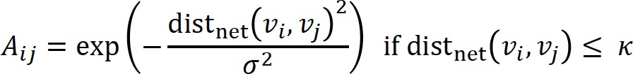
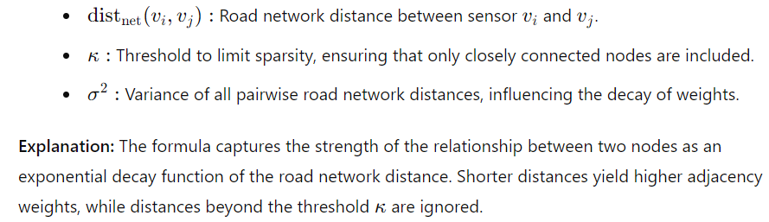
Distance Adjacency Calculation
Weighted Adjacency Matrix (Aij​): Represents the connectivity between nodes (vi and vj) based on road network distances.

Slide 33
Diffusion Convolution:
Models the spatial diffusion of traffic flow over a graph.
Captures spatial dependencies via in-degree and out-degree diffusion operations:
In-degree diffusion: Represents traffic flow entering a node.
Out-degree diffusion: Represents traffic flow leaving a node.
Recurrent Neural Networks (RNNs):
DCRNN uses Gated Recurrent Unit (GRU) cells to capture temporal dynamics of traffic.
Update Gate , Reset Gate , Candidate Hidden State , Final Hidden State. These ensure efficient learning of short-term and long-term dependencies in traffic data.

Slide 34
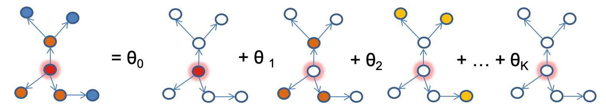
Diffusion convolution
Diffusion Convolution models the propagation of information over a graph by simulating a diffusion process.
Diffusion Convolution models the flow of information across a graph by considering both incoming (in-degree) and outgoing (out-degree) relationships between nodes

Slide 35
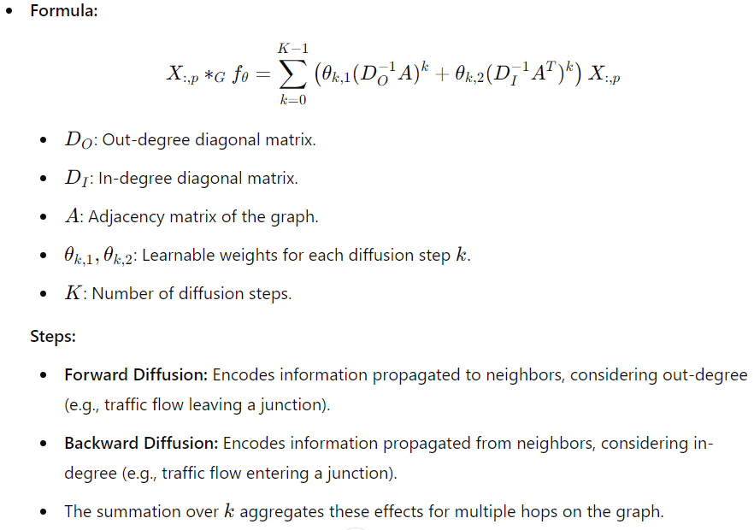

Slide 36
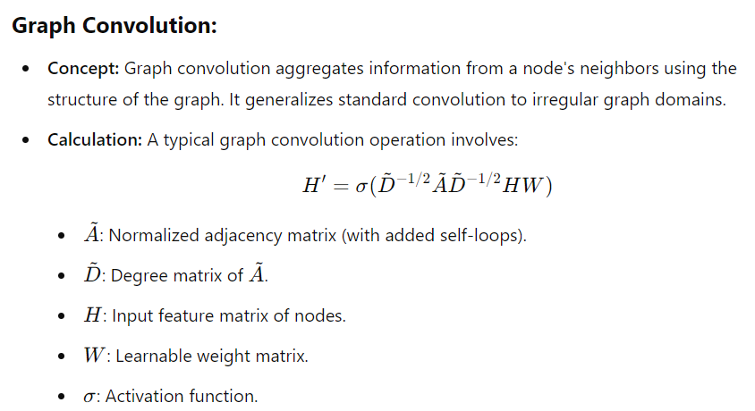

Slide 37
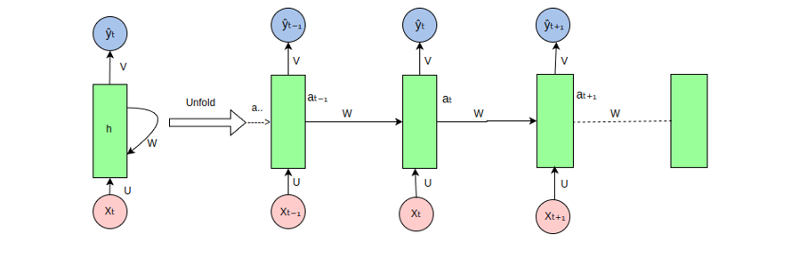
Recurrent Neural Network

Slide 38
Encoder decoder Framework of DCRNN
Current time
X₄
X₅
X₆
DCGRU
DCGRU
DCGRU
DCGRU
DCGRU
DCGRU
x₁
x₂
x₃
<GO>
X₄
X₅

Slide 39
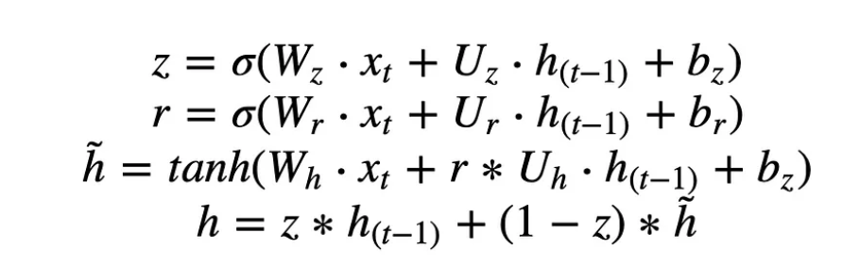

GRU Cell
z_{𝑡}: Fraction of new information to keep.(Update)
𝑟_{𝑡} : Fraction of past information to reset.(Reset)
: Updated memory content.
(Candidate Hidden State)
ℎ_{𝑡}: Final combined hidden state.(FInal Hidden State)

Slide 40
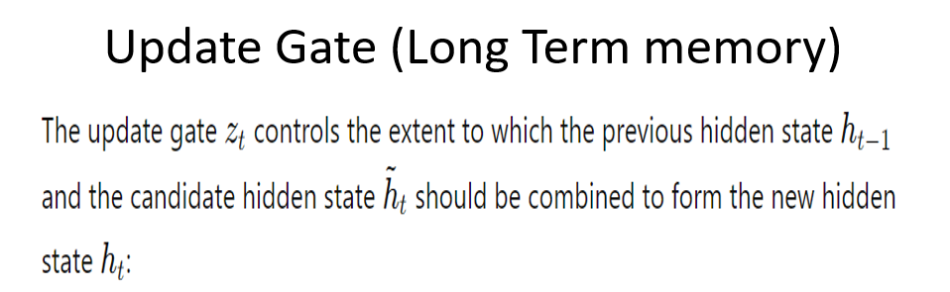
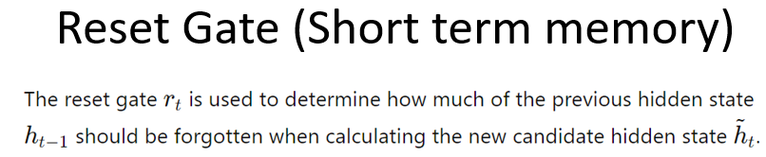

Slide 41
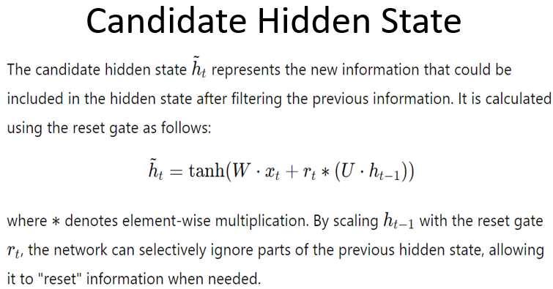

Slide 42
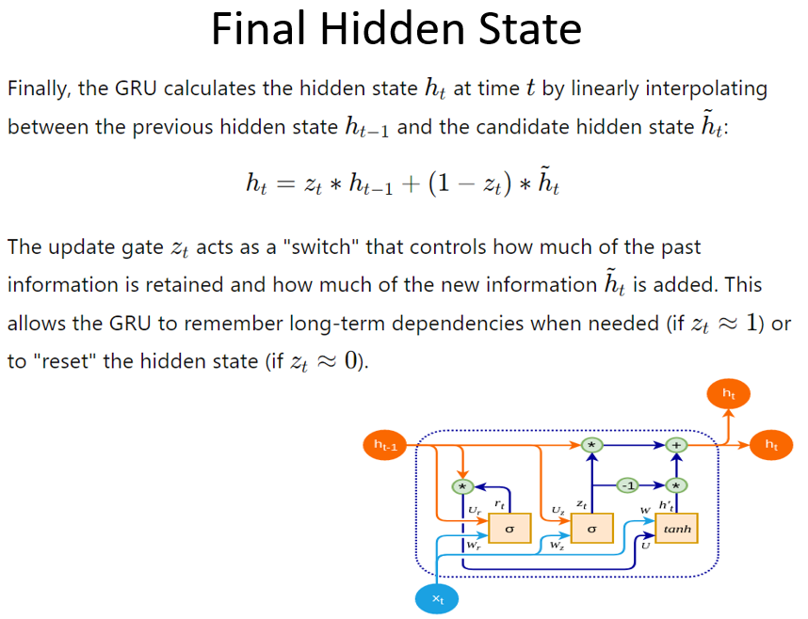

Slide 43
DCRNN cell
𝑢_{𝑡} = 𝜎(𝑤_{𝑢∗𝐺}[ℎ_{𝑡–1}, 𝑥_{𝑡}])
𝑟_{𝑡} = 𝜎(𝑤_{𝑟∗𝐺}[ℎ_{𝑡–1}, 𝑥_{𝑡}])
𝑐_{𝑡} = 𝑡𝑎𝑛ℎ(𝑤_{𝑐∗𝐺} [𝑟_{𝑡}∗ ℎ_{𝑡–1}, 𝑥_{𝑡}]) ℎ_{𝑡} = (1 − 𝑢_{𝑡}) * ℎ_{𝑡–1} + 𝑢_{𝑡} ∗ 𝑐_{𝑡}

Slide 44
How Graph Convolution Modifies the Gates?
The incorporation of graph convolution (G) in DCRNN fundamentally changes how the update and reset gates operate compared to a standard GRU because it allows these gates to model spatial dependencies in addition to temporal dynamics.
In a normal GRU, the gates operate independently per node or feature without considering relationships between nodes.
In DCRNN, graph convolution enables the gates to dynamically adapt based on the structure of the graph:
Neighbor Influence: A node's gates are influenced by its neighbors, which is essential for spatiotemporal data like traffic or sensor networks.
Propagation of Information: Information from connected nodes is propagated through the graph during every update/reset step, leading to a richer, more context-aware representation.

Slide 45
Update Gate (𝑢_{𝑡} ​):
Standard GRU: Determines how much of the past state (ℎ_{𝑡–1}) to retain for the current state, based on local information.
DCRNN: 𝑢_{𝑡} is influenced not only by the node's past state but also by the states of its connected neighbors in the graph.
The graph convolution aggregates information from neighboring nodes, enabling 𝑢_{𝑡} ​ to capture spatial patterns (e.g., how traffic at nearby sensors affects the current sensor).

Slide 46
Reset Gate (rt​):
Standard GRU: Controls how much of the past state (ℎ_{𝑡–1} ​) should be "forgotten" when calculating the candidate state.
DCRNN: 𝑟_{𝑡} incorporates spatial dependencies, deciding how much of the neighbor-influenced state should be reset.
This ensures that the reset operation respects graph relationships (e.g., if a traffic event at one sensor strongly affects another, it might retain more history).

Slide 47
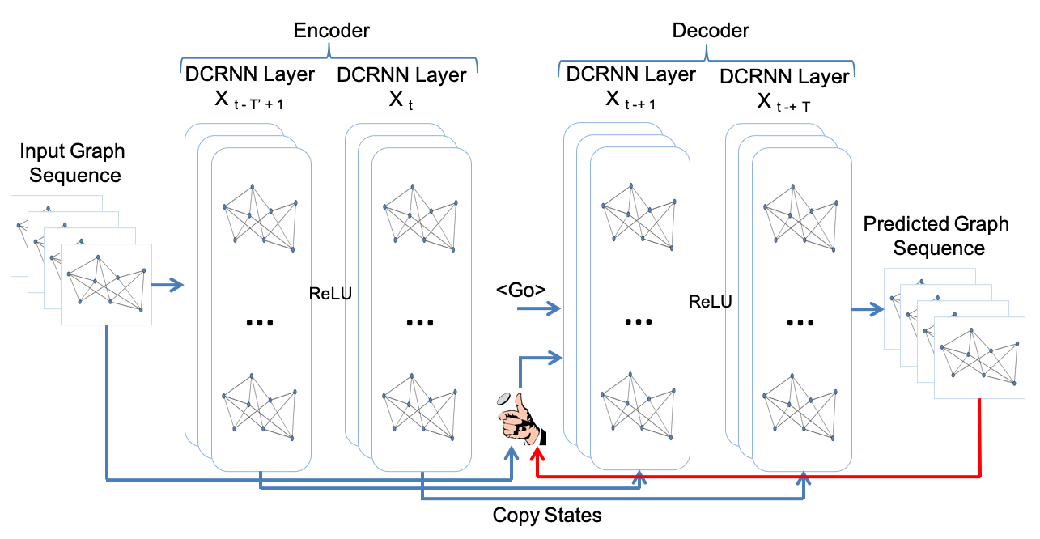
Traffic forecasting using DCRNN

Slide 48
Predicted graph sequence:
Input Graph Sequence: The input is a sequence of graphs where nodes represent sensors or locations, and the edges represent their relationships (e.g., road connectivity or geographical proximity). The node features (e.g., traffic speed, volume, or congestion level) are derived from the dataset.
Encoder: The encoder processes the input graph sequence and captures temporal dependencies using recurrent layers (like GRU with diffusion convolution). It outputs a hidden state that represents the encoded spatiotemporal features up to the current time step.
Decoder: The decoder uses the hidden state from the encoder as its initial input and predicts the graph features step-by-step for future time intervals. The decoder also employs recurrent layers to maintain temporal continuity.
Output Graph Sequence: The output graphs predict traffic conditions (e.g., average speed or congestion levels at each node) for the future time steps. Each node's value in the output graph corresponds to the predicted feature (e.g., traffic speed) at that location for a specific future time step.

Slide 49
Scaling DCRNN on HPC systems
Domain decomposition for large networks
Partition large graph into sub-graph
Run DCRNN for each sub-graph on a compute node
Combine the results and forecast traffic
Simultaneous execution of DCRNN

Slide 50

Graph partitioning using Metis
3 major phases
coarsening
initial partitioning
refinement
Key advantage
millions of vertices in few seconds
G₁
…
…
^{coarse}ning
refine^{ment}
…
…
G_{n}
initial partitioning

Slide 51
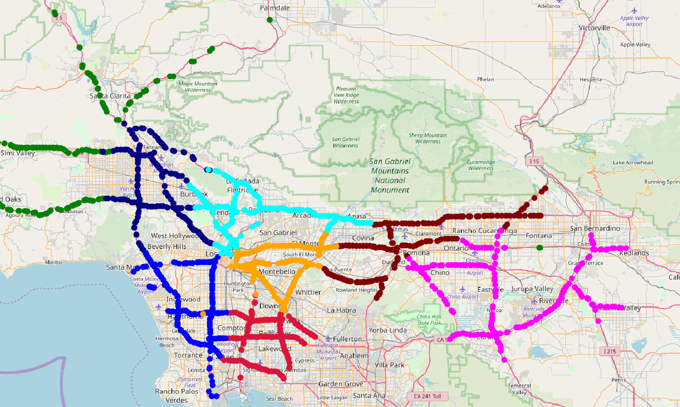
Partitions on the map
Partition 1
Partition 2
Partition 8
Partition
Partition 5
Partition 6
Partition 7
Partition 4
Partition 3

Slide 52
Coarsening
Definition: The process of reducing the size of the graph by merging nodes and edges while preserving its structural properties.
Goal: Simplify the problem by creating a smaller, easier-to-manage graph.
Steps:
Identify clusters of nodes to merge.
Combine nodes into supernodes.
Adjust edges to reflect the new graph structure.
Benefits:
Reduces computational complexity.
Facilitates efficient initial partitioning

Slide 53
Initial Partitioning
Definition: Dividing the coarse graph into parts or clusters to minimize edge cuts and balance node weights.
Techniques:
Recursive bisection.
Spectral methods.
Heuristic approaches.
Key Factors:
Maintain balance between partitions.
Minimize communication cost (edge cuts).
Outcome: A preliminary, but potentially unoptimized, partition.

Slide 54
Refinement
Definition: Improving the quality of the initial partition by fine-tuning the boundaries between partitions.
Methods:
Local optimization algorithms (e.g., Kernighan-Lin, Fiduccia-Mattheyses).
Move nodes between partitions to reduce edge cuts.
Objective:
Achieve a balance between partitions.
Further reduce the communication cost.
Benefits:
Optimized partitions for better performance.

Slide 55
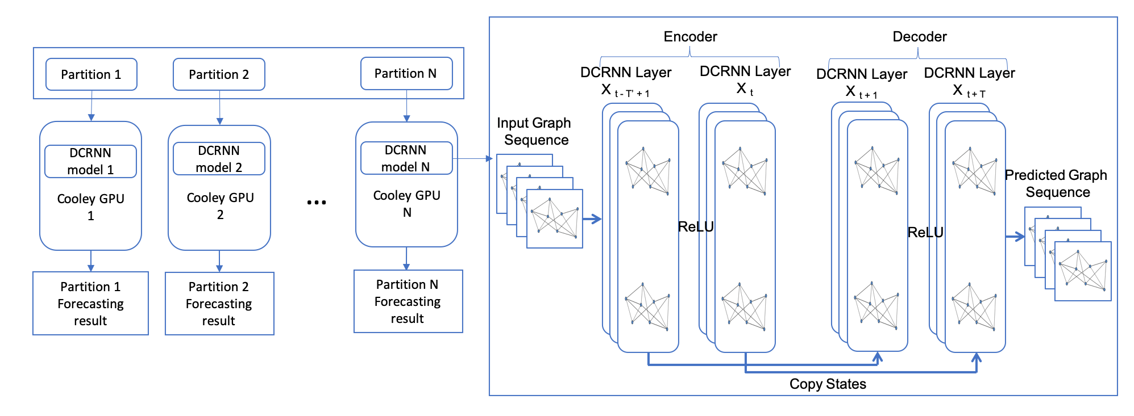
Simultaneous execution of DCRNN

Slide 56
Data set
Number of partitions | Stations per partition (aprox)
2 | 5580
4 | 2790
8 | 1395
16 | 697
32 | 348
64 | 174
128 | 87
256 | 43
512 | 21
1024 | 11
Total stations: 11160
Divide the whole data set in different number of partitions
Summary
DCRNN captures the spatial as well as temporal dynamics well
DCRNN is scalable for large network without performance degradation

Slide 57
Attention Temporal Graph Convolutional Network
It is a machine learning model designed for traffic forecasting.
It combines the power of Graph Convolutional Networks (GCNs) to capture spatial dependencies between nodes (e.g., intersections in a road network) and Recurrent Neural Networks (RNNs) to model temporal dependencies (how traffic evolves over time).
Additionally, it integrates an attention mechanism to dynamically focus on the most important temporal features, improving its predictive accuracy.

Slide 58
How Does A3TGCN Work?
1. Input Data:
The road network is represented as a graph G=(V,E,A):
V: Set of nodes (e.g., traffic sensors or intersections).
E: Set of edges (e.g., roads connecting intersections).
A: Adjacency matrix representing connectivity between nodes.
Traffic data (e.g., speed, flow) is associated with nodes, forming a time-series graph.
Graph Convolutional Network (GCN): Captures spatial relationships between nodes by aggregating information from neighboring nodes.
Recurrent Neural Network (GRU): GRUs (a variant of RNNs) are used to process the time-series data, learning sequential patterns such as recurring traffic peaks during rush hours.

Slide 59
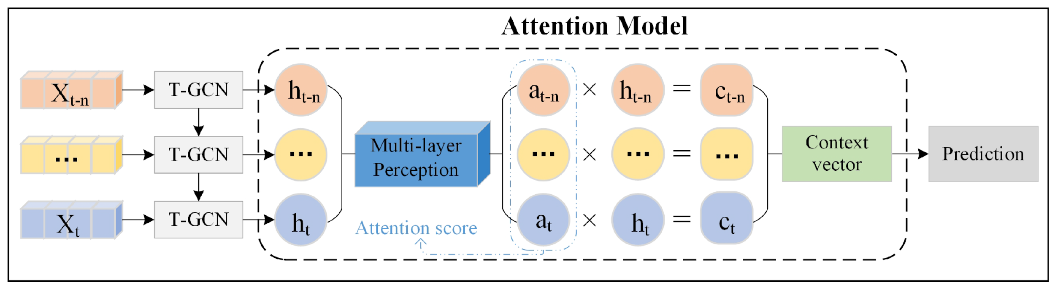
Attention Mechanism:
Dynamically weights the importance of different time steps in the sequence, helping the model prioritize significant patterns (e.g., unusual traffic surges).

Slide 60
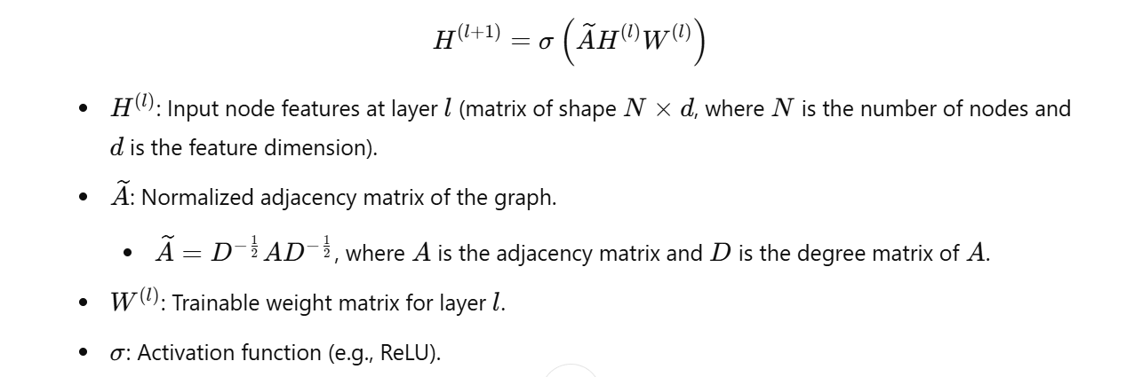
Mathematics Behind A3T-GCN
Graph Convolution layer
The GCN captures spatial dependencies in the traffic network graph. The operation at each layer of the GCN is defined as:

Slide 61
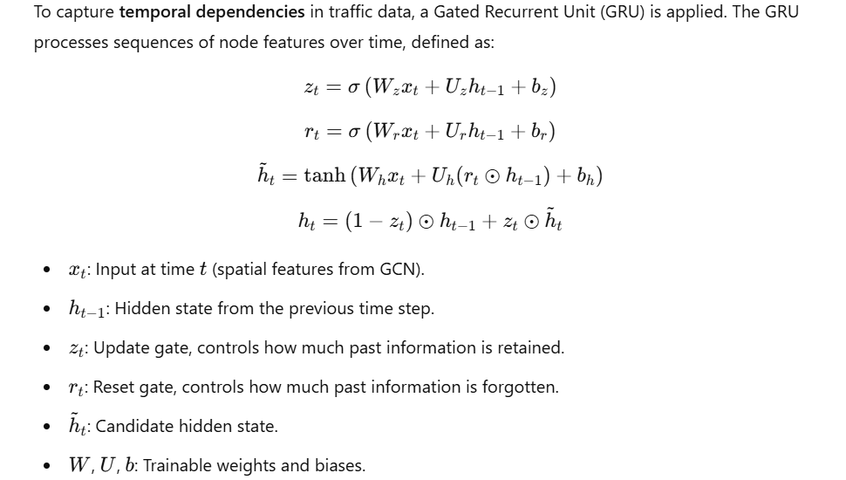
Temporal Modeling with GRU

Slide 62
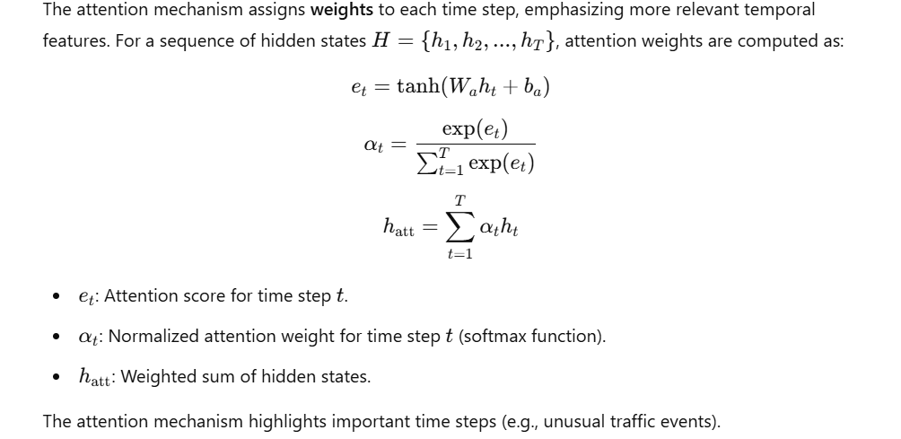
Attention Mechanism

Slide 63
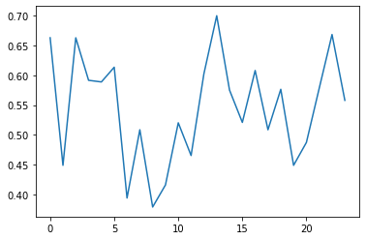
Results and Analysis
This plot represents the traffic data over time for a specific traffic sensor, likely extracted from the dataset where
X axis represents 24hrs time and Y axis Represents the flow from sensor number one.

Slide 64
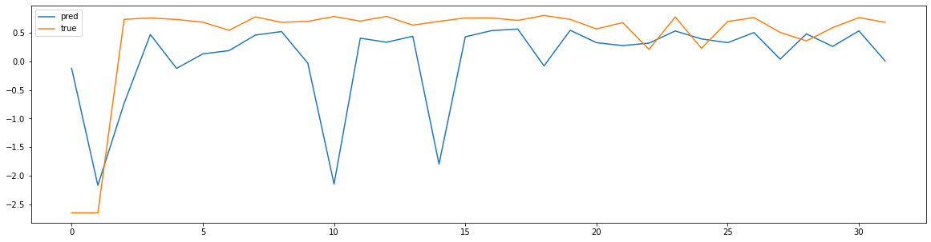
This plot can demonstrate:
Model performance: The ability of the model to forecast traffic patterns.
Error trends: Illustrate how prediction accuracy degrades with increasing time horizons, common in time-series forecasting tasks.
Here RMSE Value is 0.52 .

Slide 65
Why to choose DCRNN over A3TGCN?
Captures Directionality in Traffic : Traffic flow is inherently directional (e.g., congestion propagates upstream). DCRNN's diffusion convolution explicitly models this directionality, while A3TGCN does not inherently account for it.
Handles Long-Term Dependencies: DCRNN uses RNNs to model temporal dependencies, which are particularly effective for capturing long-term patterns in traffic data.
Proven Performance: DCRNN has been extensively evaluated on traffic forecasting datasets (e.g., METR-LA, PEMS-BAY) and has consistently demonstrated state-of-the-art results for long-horizon predictions.

Slide 66
Conclusion and Future Scope
This project establishes a strong foundation for an Intelligent Transport System by developing robust traffic prediction models like LSTM, DCRNN, and GAT, which effectively capture spatial-temporal dependencies. Comprehensive preprocessing and evaluation validate the models' accuracy and scalability for large networks.
The next step is to implement the route optimization module, leveraging Generative AI and LLMs to deliver real-time, personalized route suggestions. This work highlights the potential of AI-powered solutions to reduce congestion, improve commute efficiency, and support sustainable urban mobility.
Future Scope -
After analyzing multiple models, including LSTM, A3TGCN and DCRNN, we believe that DCRNN will be the most effective model for traffic prediction due to its ability to capture spatial-temporal dependencies, making it a strong candidate for our project. We plan to implement this model in the future.
We have 2 datasets, METRLA and PEMS. Since the PEMS dataset offers more comprehensive features, we have decided to proceed with PEMS to maximize the model’s performance and provide more insightful results.

Slide 67
References
https://www.sciencedirect.com/science/article/pii/S0925231224012128
https://ieeexplore.ieee.org/stamp/stamp.jsp?tp=&arnumber=8903252
https://arxiv.org/pdf/2006.11583

Slide 68
Thank you!

